Slide 1
Low
tolerance
(≥50%)
High
tolerance
(<50%)
A. digitifera
A. millepora
Proportion of dead fragments (%)
A. tenuis
Colony/genotype

Slide 2
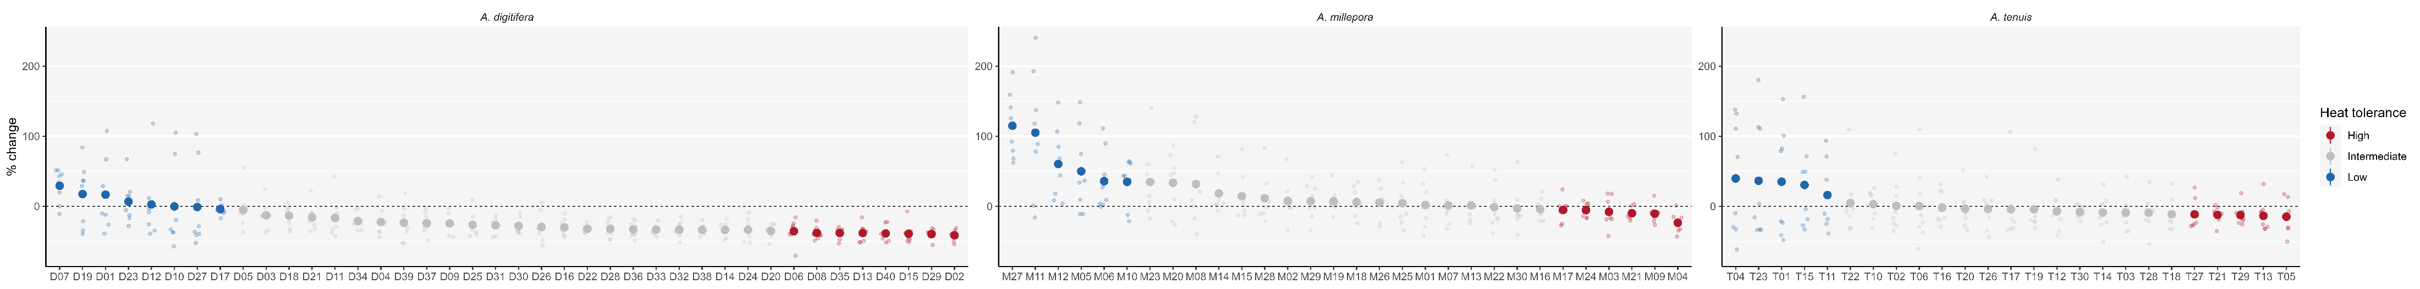
A. digitifera
Low
tolerance
(top 20% “whitened”)
High
tolerance
(bottom 20%)
A. millepora
Percent mean intensity gray (MIG) change (%)
A. tenuis
Colony/genotype

Slide 3
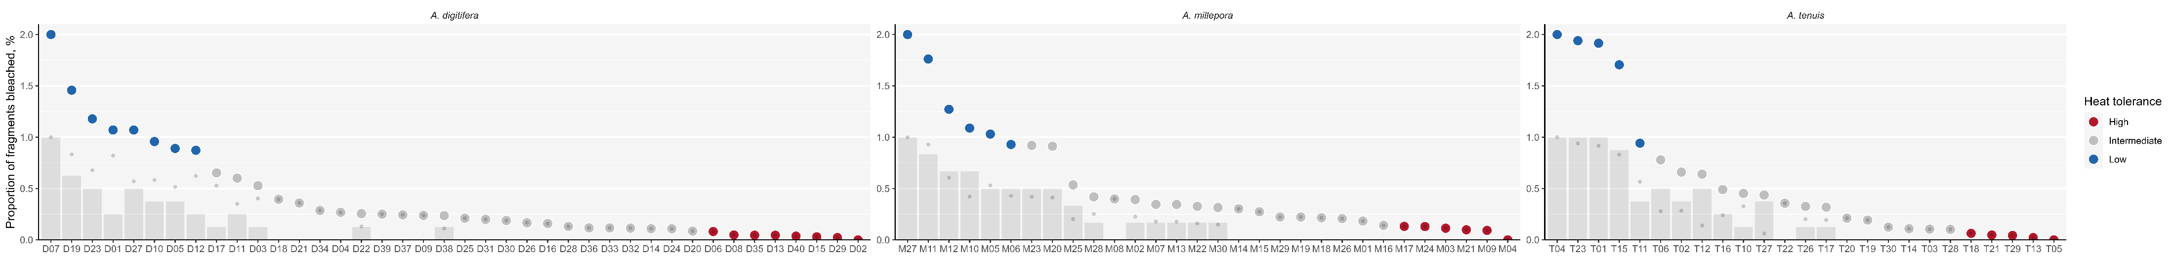
A. digitifera
Low
tolerance
(top 20%)
High
tolerance
(bottom 20%)
A. millepora
Min-max normalized(% fragment mortality + % MIG change)
A. tenuis
Colony/genotype

Slide 4
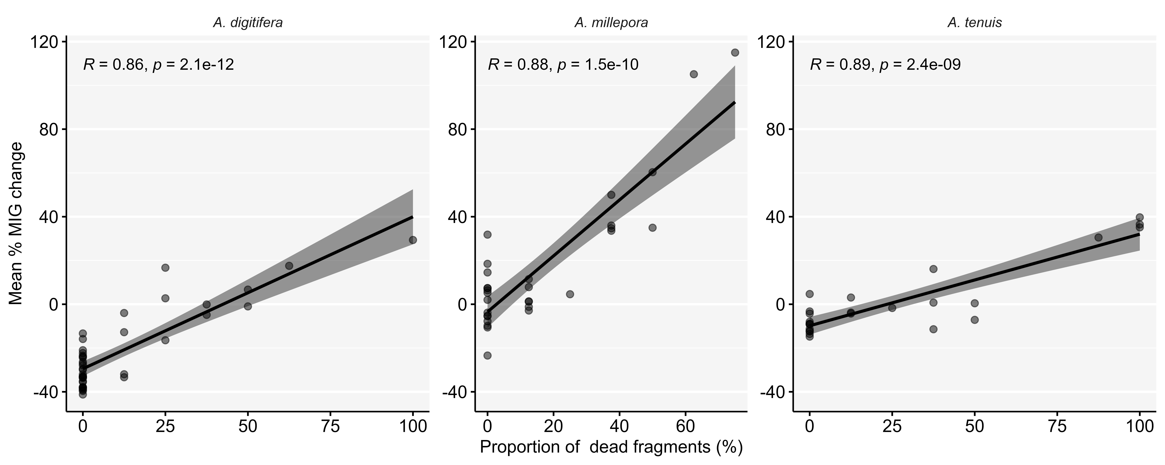

Slide 5
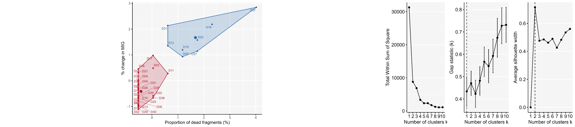
A. digitifera
Optimal number of clusters

Slide 6
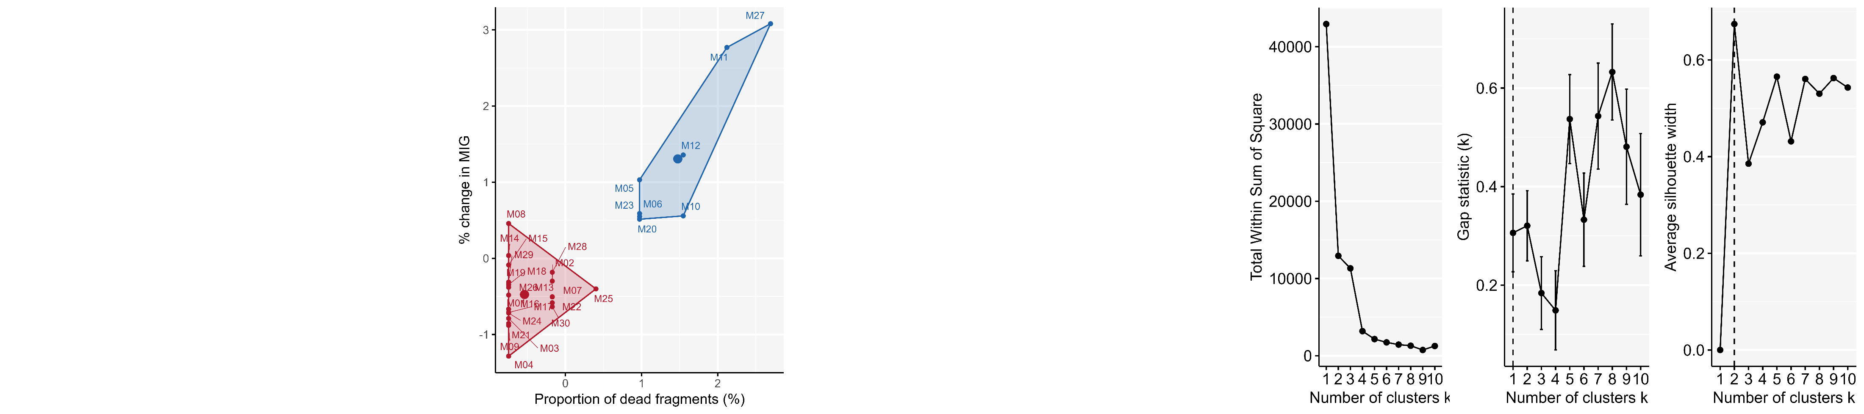
A. millepora
Optimal number of clusters

Slide 7
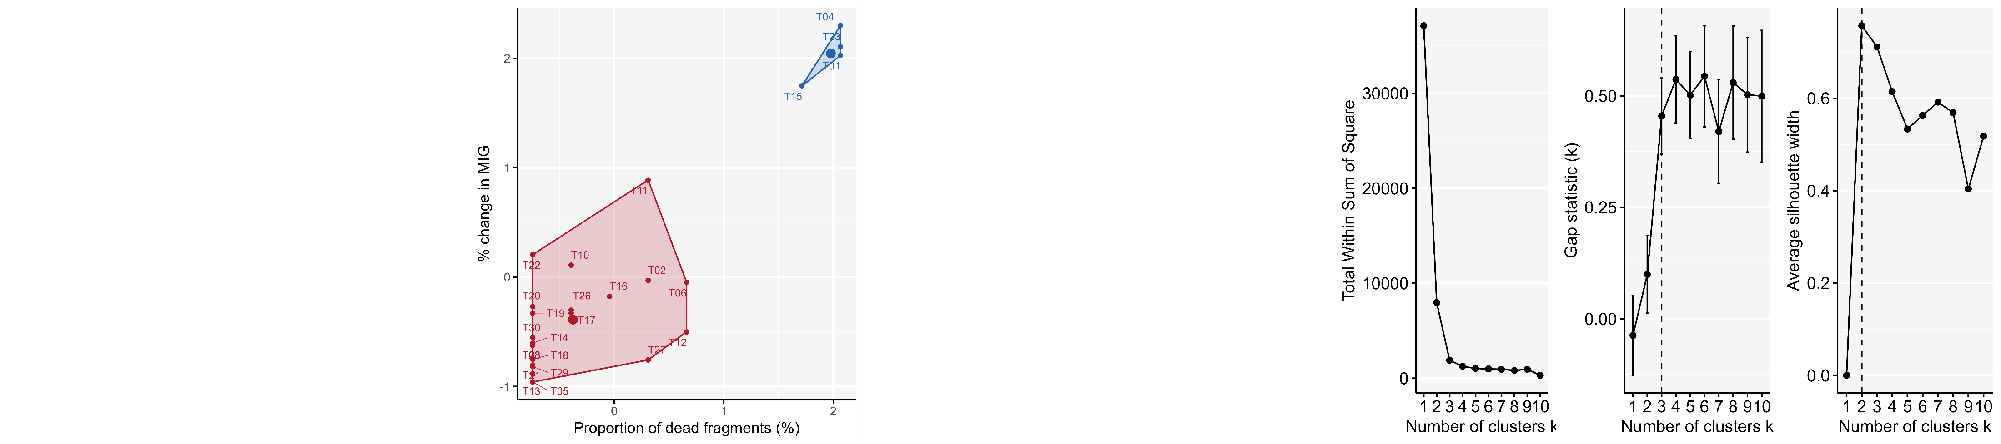
A. tenuis
Optimal number of clusters

Slide 8
A. digitifera
Optimal number of clusters
A. millepora
Percent change in MIG ()%
A. tenuis

